Slide 3
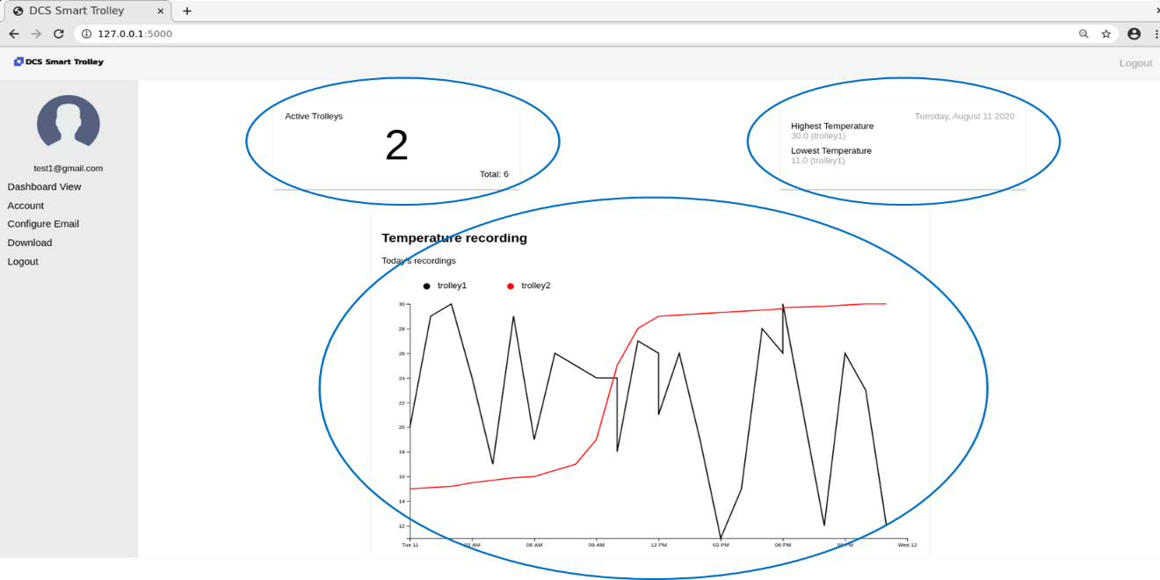
toolbar
Active Trolley
Summarization
main
Temperature Chart
sidenav

Slide 4
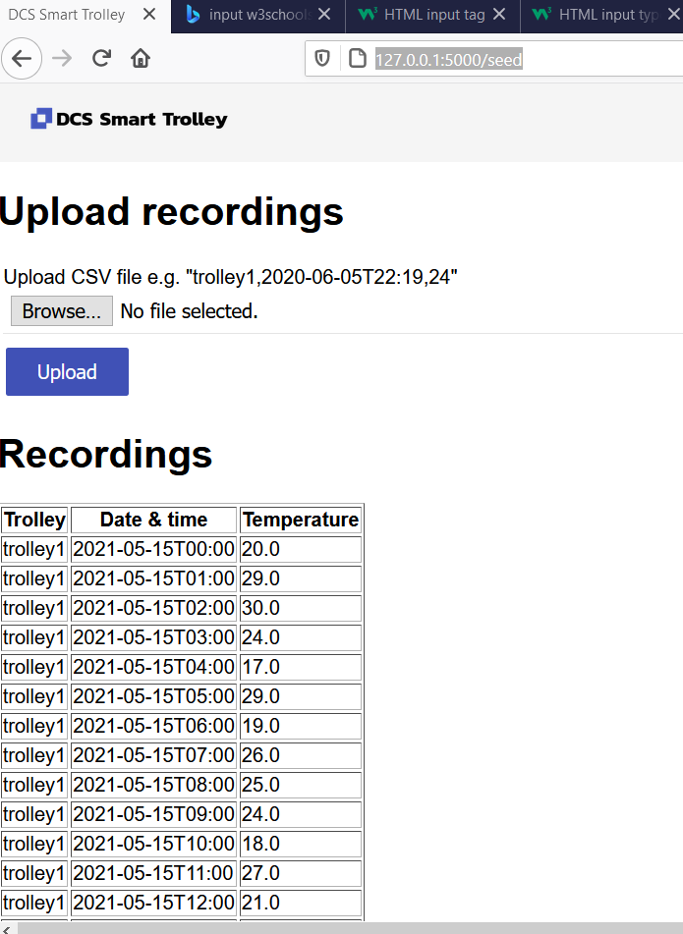
toolbar

Slide 5
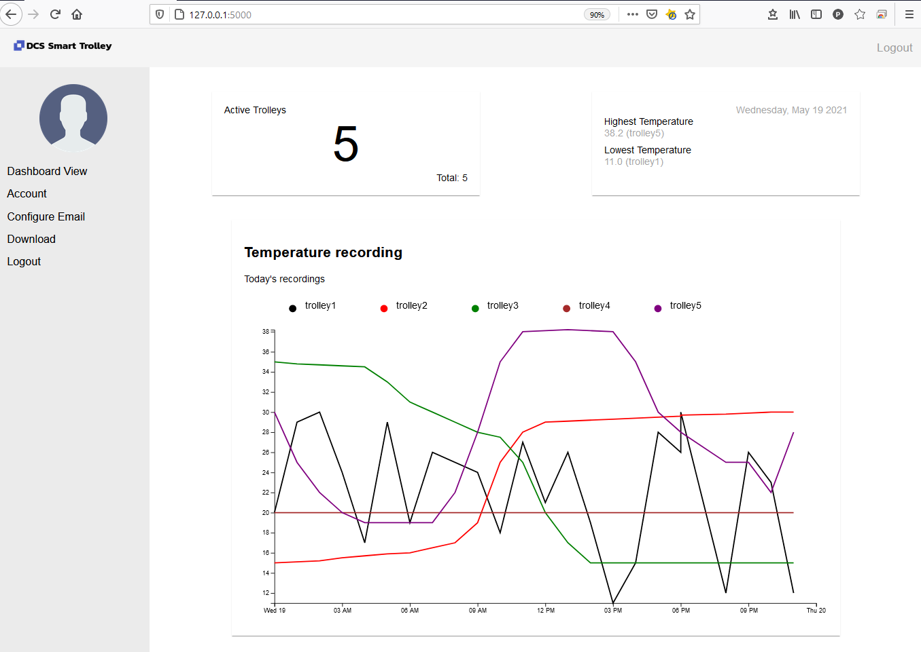
toolbar
Active Trolley
Summarization
main
Temperature Chart
sidenav

Slide 6
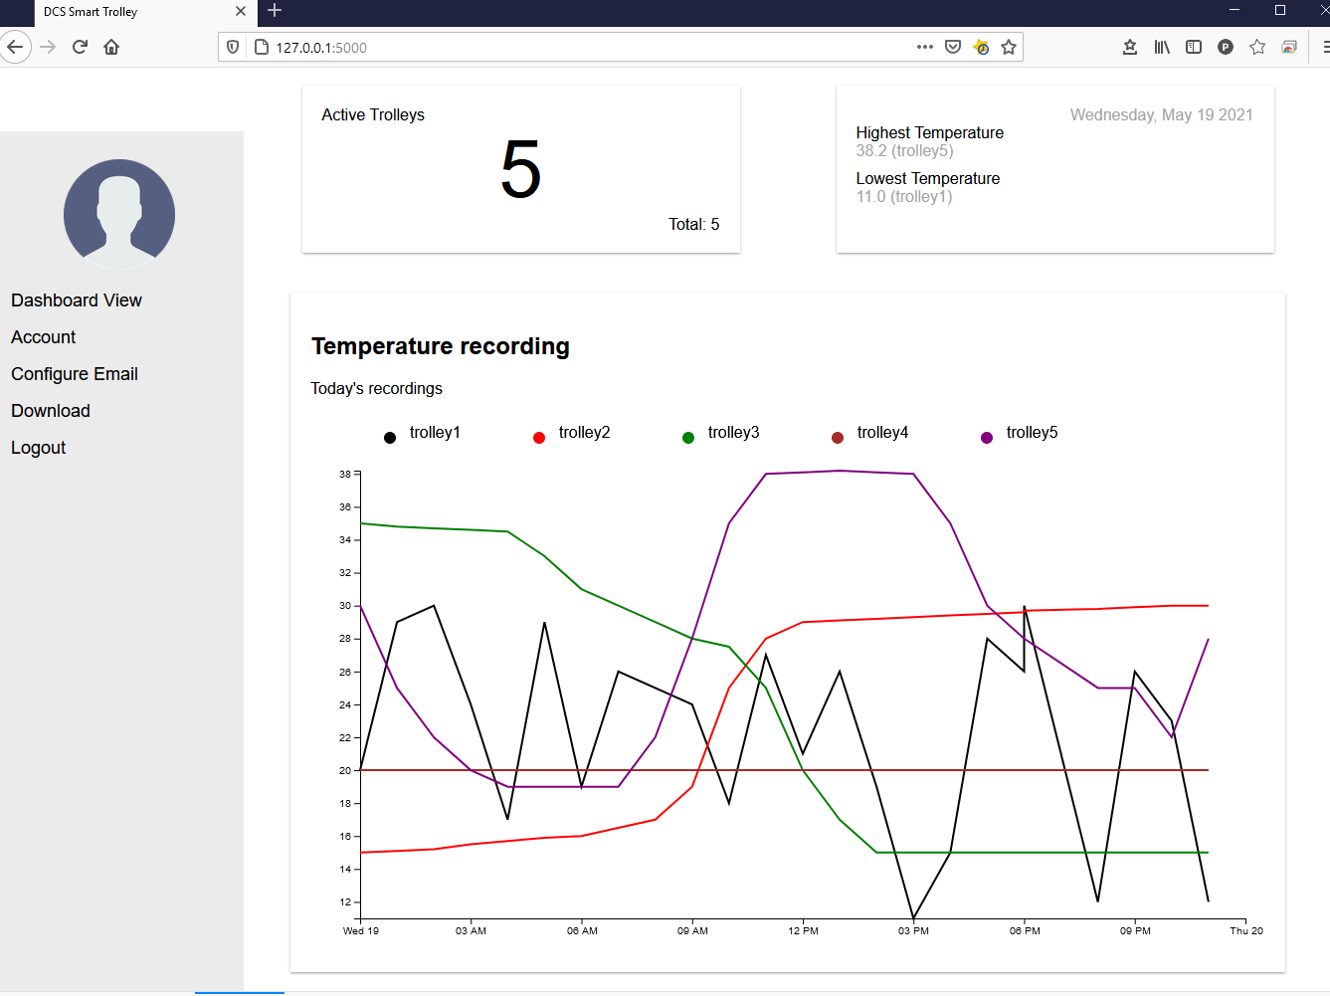
toolbar
Active Trolley
Summarization
main
Temperature Chart
sidenav

